Slide 1
School of Economics
(A UGC-SAP Department)
Devi Ahilya University, Indore
Welcomes
The Hon’ble Members of NAAC Peer Team

Slide 2
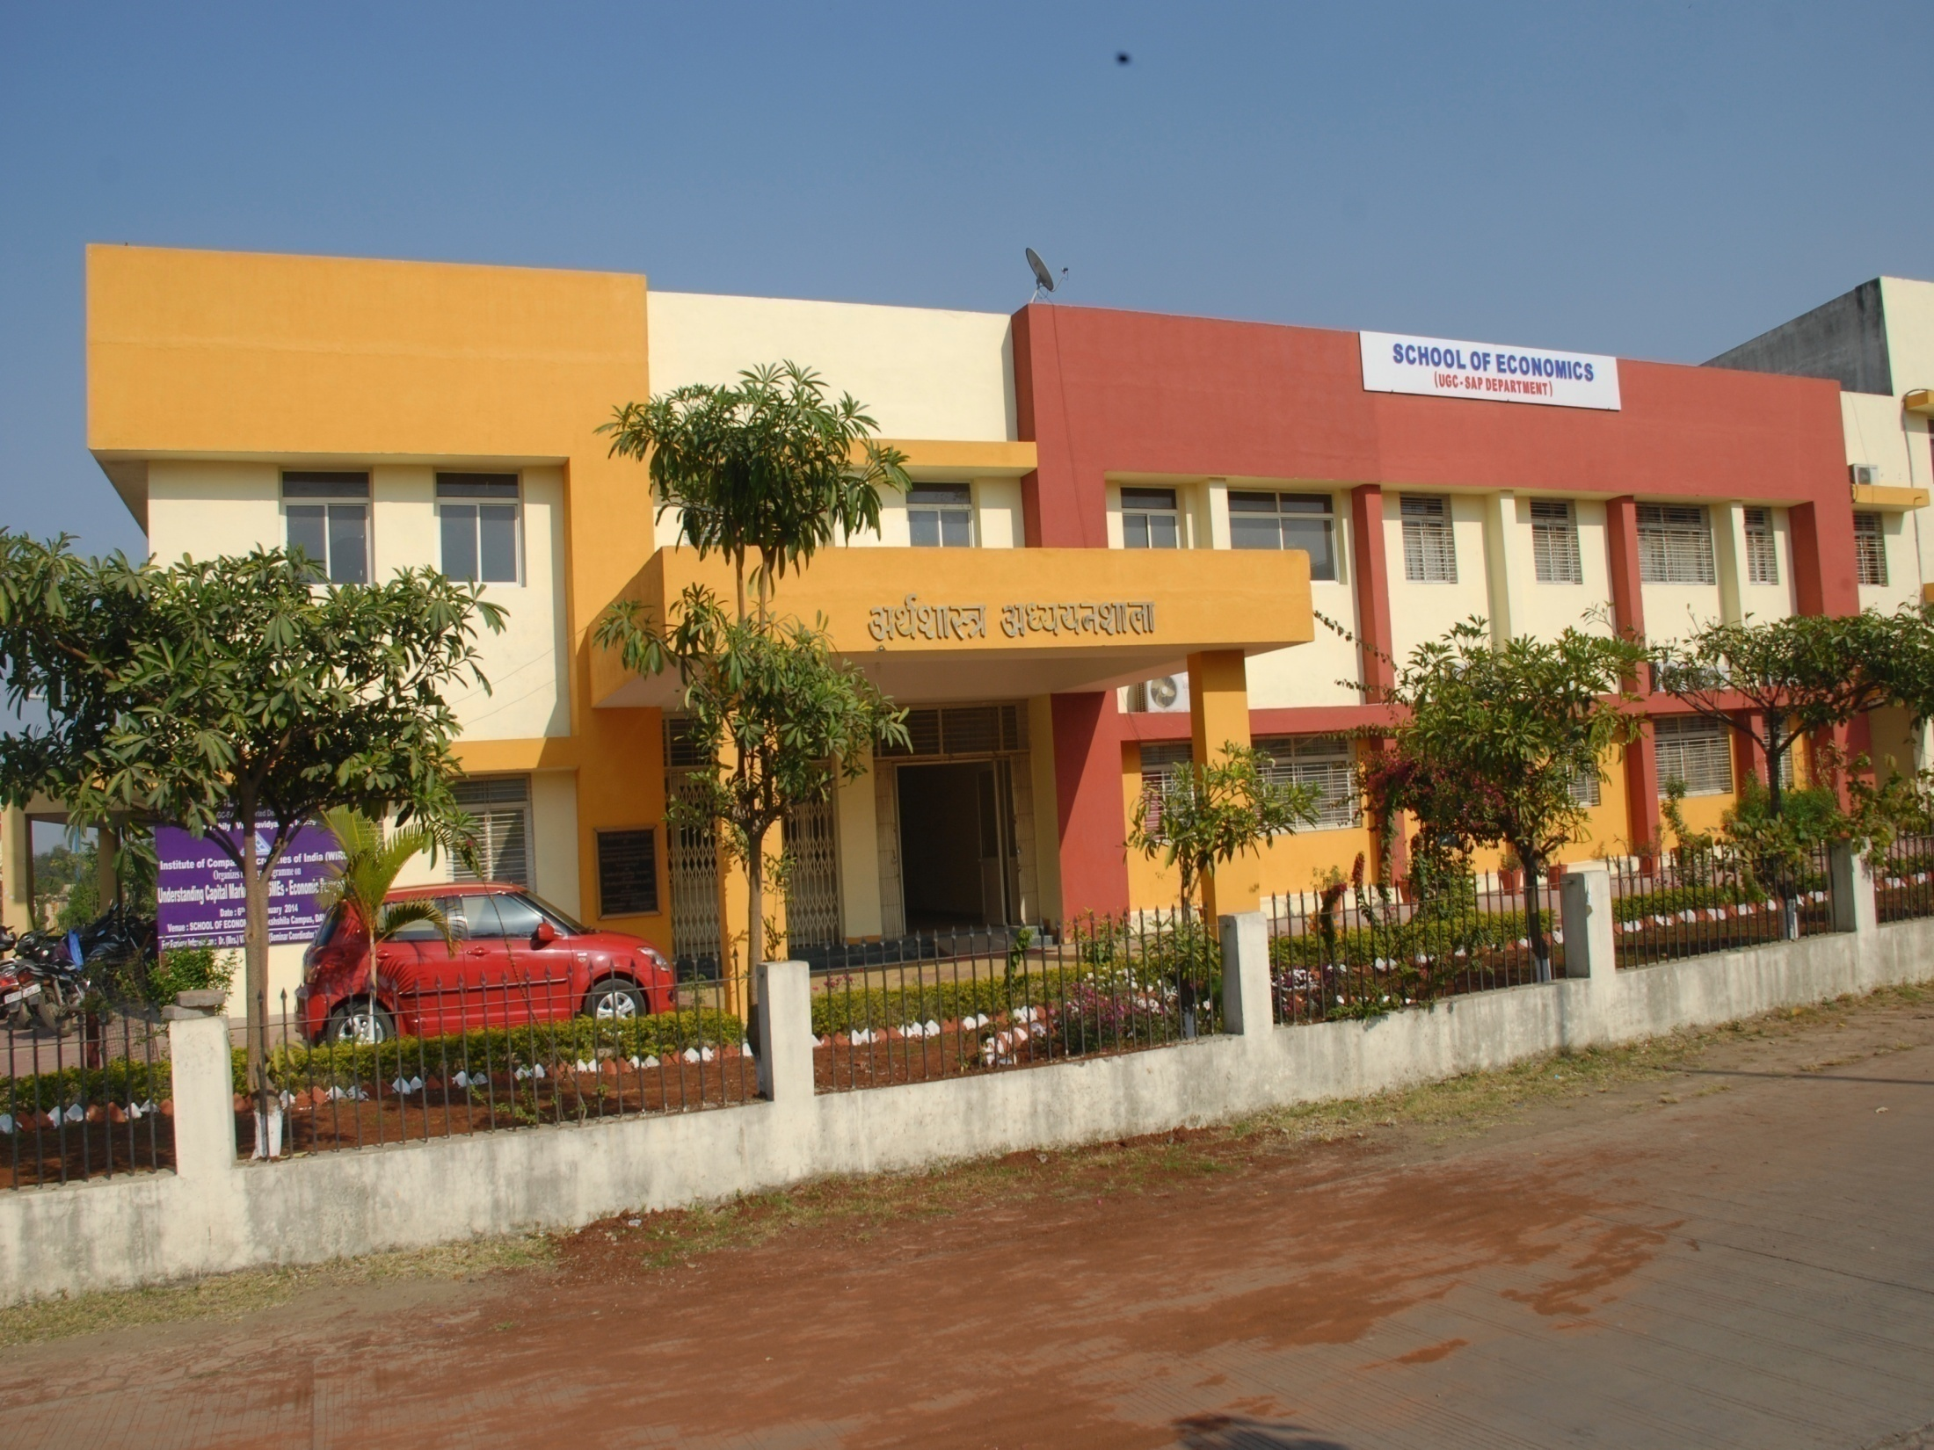

Slide 3
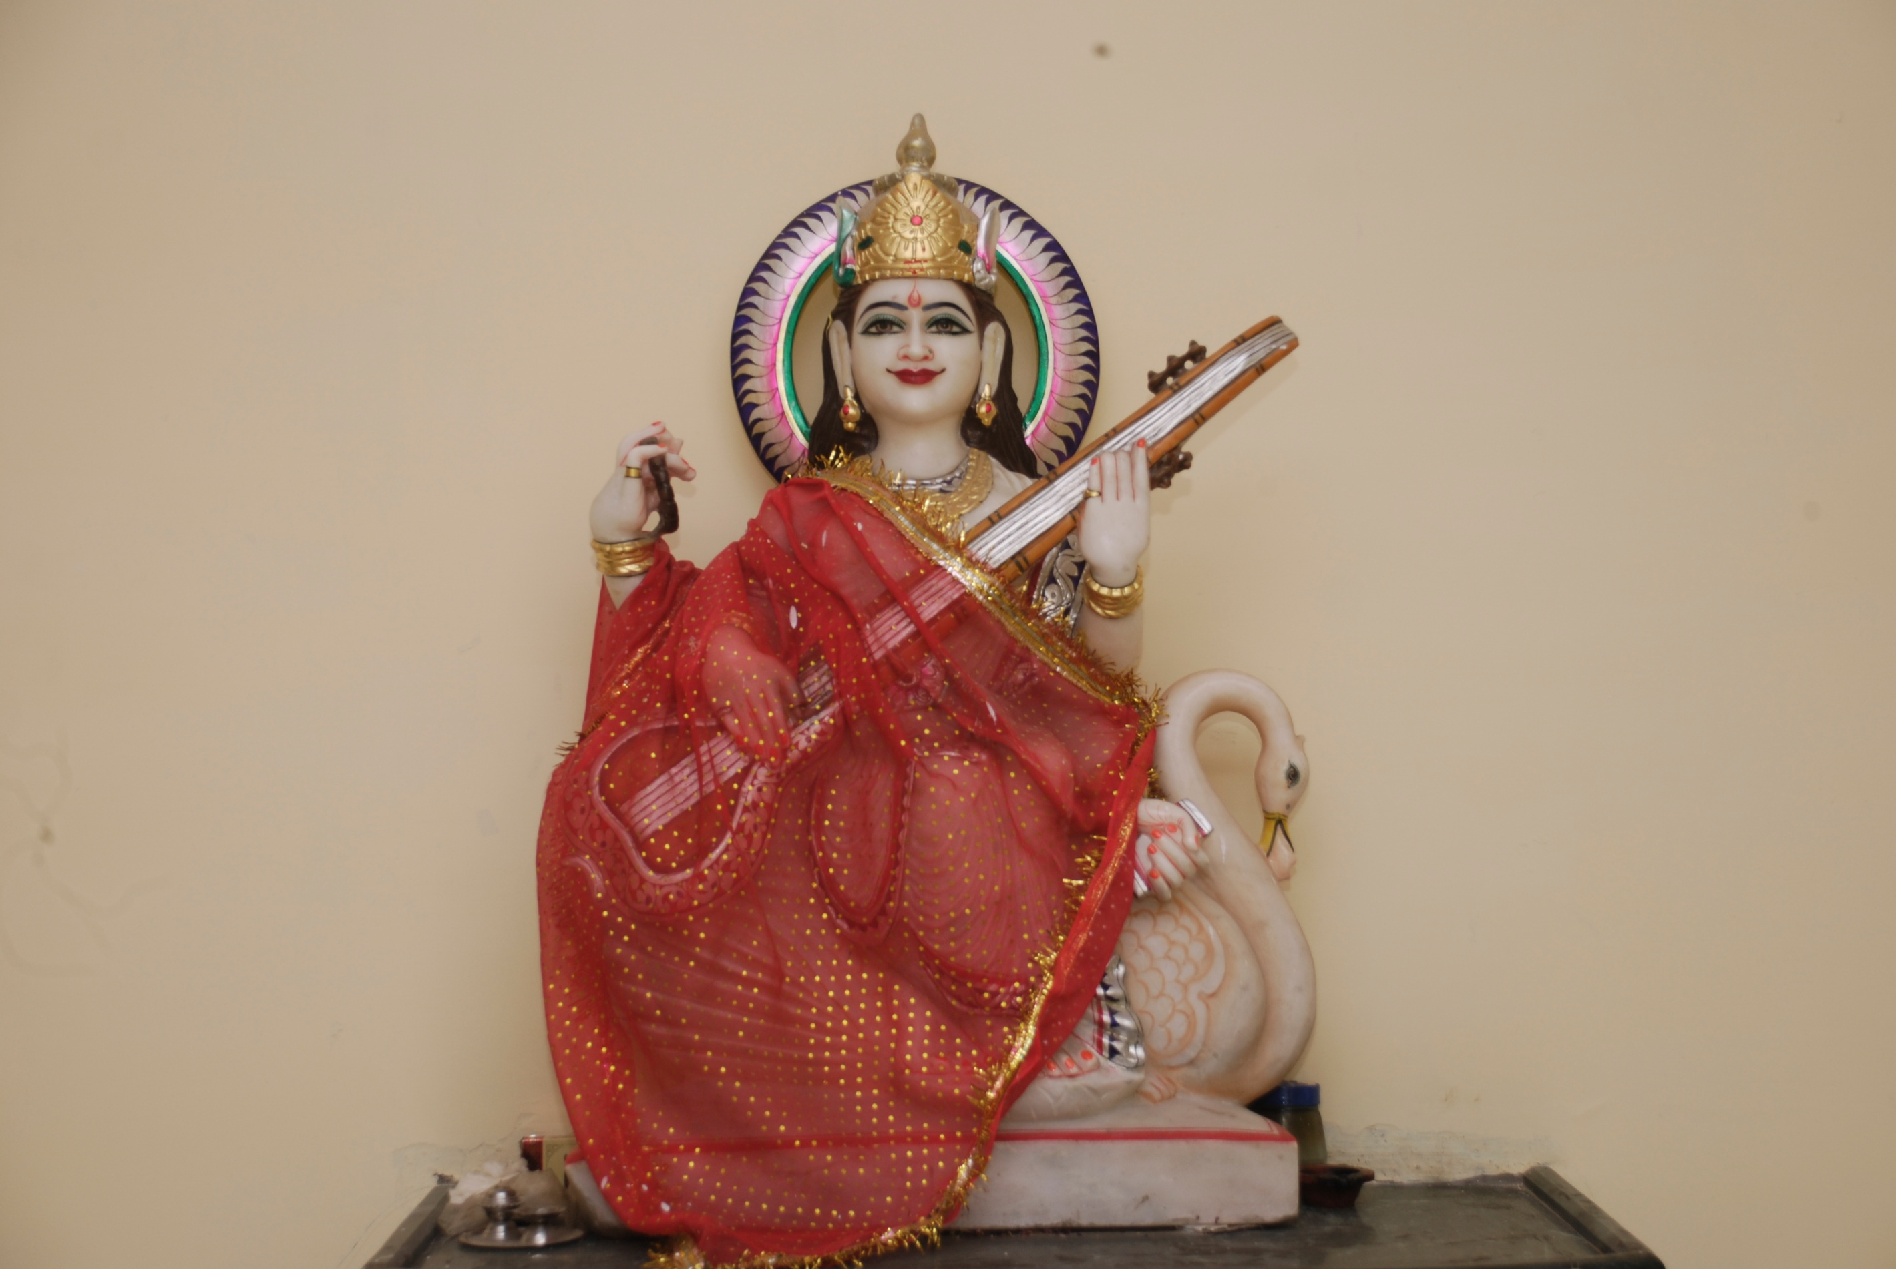

Slide 4
School of Economics
Established in 1976 to impart quality education and research in the field of economics with teaching of M.A. M. Phil and Ph.D. (Economics).
Focus Areas: Quantitative Economics, Regional Economics and Tribal Economics.
First to start Self-supporting Post Graduate Professional Programmes: Business Economics, International Business and Financial Services.
Departmental Website : www.soedavv.ac.in

Slide 5
Vision And Mission
Creating an environment that nurtures, motivates and inspires development of managerial giftedness.
Inculcating best blend of Management and Economics.
Imparting comprehensive education for holistic development of an individual’s personality with a humane and global outlook.
Synthesizing in its educational process, an entrepreneurial skill with focus on functional areas of Economics in the field of Finance and International Business.

Slide 6
Programmes
All Programmes are
Multi Disciplinary
Computer, Finance,
Management, Soft skills & Communication.

Slide 7
Salient Features
State Planning Commission Chair on “Micro-Economic Governance”
ICSSR Support for Research and Training
UGC-SAP Support at DRS – Phase II
Publication of MPEA Journal since 2008
National agencies support for student related activities
Diversified Faculty Members
Co-curricular activities: Spandan and Colors
Participation in the Development Issues of the Region

Slide 8
Our Associations
The State Planning Commission, Bhopal
Forward Markets Commission (FMC), Mumbai
Indian Council of Social Sciences Research(ICSSR)
Madhya Pradesh Economic Association (MPEA)
Development Foundation, Indore
Institute of Chartered Accountants of India (ICAI)
CII - Indore Chapter
The Multi Commodity Exchange (MCE)
The Institute of Company Secretary of India

Slide 9
Faculty and Staff
Sanction Seats (16)
Professor - 2
Reader/ Associate Professor - 5
Recruited (10)
Professor - 1+3 (CAS)
Vacant Positions (6)
Professor - 1
Lecturer/ Assistant Professor -9
Number of working on Contract (6)
Reader/ Associate Professor - 0
Lecturer/ Assistant Professor - 6
Reader/ Associate Professor - 3
Lecturer/ Assistant Professor - 2
Lecturer/ Assistant professor - 6
Non Teaching Staff (14)
Sanctioned - 8
Technical Staff (1)
On Contract basis - 1
Recruited - 8
On Contract Basis - 6

Slide 10
Our Faculties
S.No. | Faculty | Designation | Qualifications
1 | Dr. Ganesh Kawadia | Professor & Head | Ph.D., M.A.Eco
2 | Dr.Gyan Prakash | Professor | Ph.D., M.A.Eco
3 | Dr. Nirupama Nagar | Professor | Ph.D., M.A.Eco
4 | Dr. Kanhaiya Ahuja | Professor | Ph.D., M.Phil, M.A.Eco M.B.A.(HR)
5 | Dr. Rekha Acharya | Lecturer, Stage III | Ph.D., M.Phil, M.A.Eco M.B.A.(HR)
6 | Dr. Sakharam Mujalde | Lecturer, Stage II | Ph.D., M.Phil, M.A.Eco
7 | Dr. Vishakha Kutumbale | Lecturer, Stage II | Ph.D., M.A.Eco, BE
8 | Dr. Akanksha Singhi | Lecturer, Stage II | Ph.D., MBE, M.A.Eco
9 | Dr. M.Vasim Khan | Lecturer | Ph.D. MBA(BE) Marketing
10 | Mrs. Ekta Rokade | Lecturer | MBA (BE) Finance
11 | Dr. Vidya Telang | Contractual Lecturer | Ph.D., MBA, ICWA
12 | Mrs. Rachana Jain | Contractual Lecturer | MBA, M.Sc.(CS) UGC-NET (Management)
13 | Mr. Dinesh Bargale | Contractual Lecturer | MBA (Finance)
14 | Dr. Sonael Sharma | Contractual Lecturer | Ph.D , M.Phil, M.A.Eco
15 | Ms. Parul Kanchan | Contractual Lecturer | MBA (IB)
16 | Mr. Mohitash Nagotra | Contractual Lecturer | MBA(BE)- Finance UGC-NET (Economics)

Slide 11
Visiting Faculty
S. No. | Name | Qualifications
1. | Ms. Ishani Maheshwari | CA
2. | Mrs. Varsha Gupta | LLM
3. | Mr. Raunak Jain | MBA
4. | Mrs. Deepali Pai | MBA,BE
5. | Mrs. Preeti Dave | MBA(Finance)
6. | Mrs. S. Puranik | MBA
7. | Mr. Amit Hasija | CA
8. | Mr. Dinesh Wadhwa | MBA
9. | Ms. Era Tiwari | M.A. (Economics)

Slide 12
Focus Area of Programmes
Ph.D
Regional Development, Social and Environmental Issues.
Trade and Development
M.Phil.
Comprehending Economic Policies
Quantitative Research Techniques
M.A
Analytical Skills through Quantitative Techniques
Environmental Economics

Slide 13
Focus Area of Programmes
MBA(BE)
Blend of Management and Economics
Quantitative Techniques and Analytical Skills
MBA(IB)
Operational Aspects of International Trade
Trade Policies and Regulations
MBA(FS)
Financial Operations and Markets
FOREX, Capital Market, and Commodity Derivatives Markets

Slide 14
Activities of 2013-14
WORKSHOPS
SPSS -17th April 2013
Pre-Eureka: ‘Entrepreneurship Development’ in association with IIT Mumbai and Nurture Talent Academy, Mumbai - 28th Sep 2013
‘Dynamics of Capital Market and Online Trading’- 25th October, 2013.
ICSSR: ’Research Skill Enhancement Programme for Social Sciences ’- Jan 03-17, 2014
REFRESHER COURSE
‘Economics and Policy’ - 23rd August, 2013 to 12th September, 2013.

Slide 15
Activities of 2013-14
SEMINARS
ICAI: ‘Goods and Services Tax’- 8th October 2013.
ICSI: ‘Capital market and Financing of SMES’-Jan 6-7, 2014
SPECIAL LECTURES
Bonnie Meyer and Larry Kerschner : ‘Gandhi’s Relevance in Today’s World: Gandhi, Geeta and Mankind’- 7th October, 2013
Dr Vijay Rana, Ex-Radio Editor, BBC: ‘Positive Thinking’- 20 December 2013
Captain Jaison Thomas : ‘Turning Potential into Performance’ - 21st September, 2013.
Captain Jaison Thomas : ‘Corporate Appearance and Expectation’ - 28th September, 2013
Mr. Rajat Ghorawat, Director Bulls Eye, Indore : ‘Recent Trends in Stock Market’- 10th October, 2013.

Slide 16
UGC-SAP (DRS Phase-II)
UGC-SAP (DRS Phase-II) from April, 2009 after successful completion of First Phase 2004-2009
The Thrust Area for the Second Phase:
Globalization, Trade and Natural Resource Management
Regional Development and Environmental Issues
Total Outlay for a period of five years:
Rs. 41 Lakhs + Two Project fellows

Slide 17
Major Research Projects
Dr. Rekha Acharya: ICSSR Project on “Employment and Income Patterns in the Informal Sector in M.P. - A Study with Special Reference to Dhar District”
Dr. Kanhaiya Ahuja: ICSSR Project on “An Empirical study of Weekly Markets for Economic Upliftment of Tribals with Special Reference to Jhabua District of M.P.”
Dr. Ganesh Kawadia: ICSSR Project on “Climate Change and Agriculture (A Study of Catchment Area of Chambal River- the Malwa Plateau of M.P.
Two faculty members have submitted research proposal for seed money to the University

Slide 18
Publications (Books)
Natural Resources, Climate Change and Economic Development (2013), Edited Book, A.K. Publication, New Delhi. (Press)
Trade and environment under WTO Regime(2012), Edited book, A.K. Publication, New Delhi.
Financial Liberalization and its Impact on Consumption and Wealth in India, (2012). A. K. Publication, New Delhi.
Contemporary Issues in Services Marketing for 21st Century, (2012), Global Research Foundation. New Delhi
Indian Banking- Technology, Innovations and Key Concerns, (2011) Kunal Book Publishers and Distributors, New Delhi.
Gandhi Sagar Pariyojana aur Malwa Paryavarniya aur Samajik Mudde (2009)- A Monograph

Slide 19
Faculty Achievements
Dr. Ganesh Kawadia
Member : Expert Group of FMC for Revival of Regional Commodity Exchanges in India (2013)
Awarded : Best Professor of Economics by World Education Congress (2013)
President : Madhya Pradesh Economic Association (2009)
Presented Paper : International conference on Knowledge Globalization organized by Suffolk University, Boston.
15 -16 Oct, 2011
Dr. Kanhaiya Ahuja
Managing Editor of MPEA Journal since 2009

Slide 20
SOE
at
A Glance

Slide 21
Auditorium

Slide 22
Computer Lab

Slide 23
Placement Cell

Slide 24
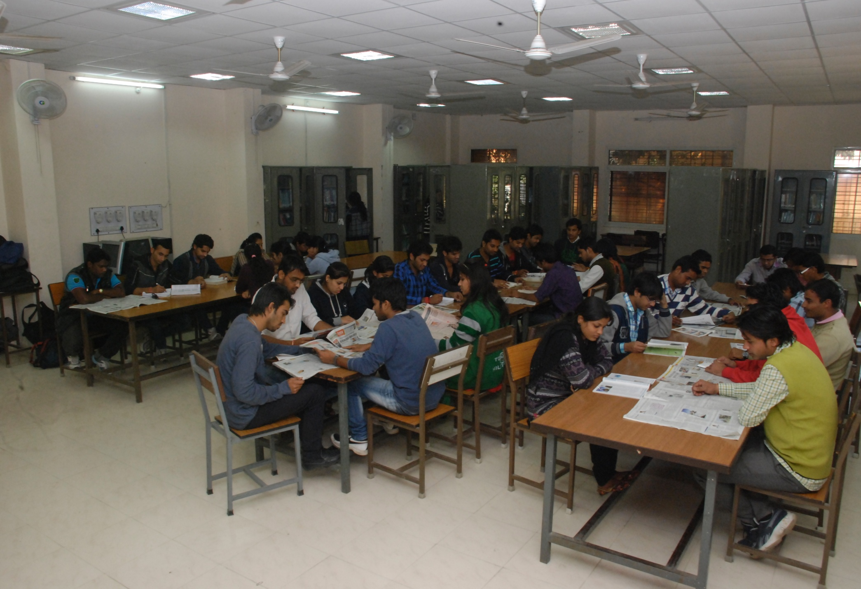
Library

Slide 25
Development prospects of Madhya Pradesh 15th September, 2012

Slide 26
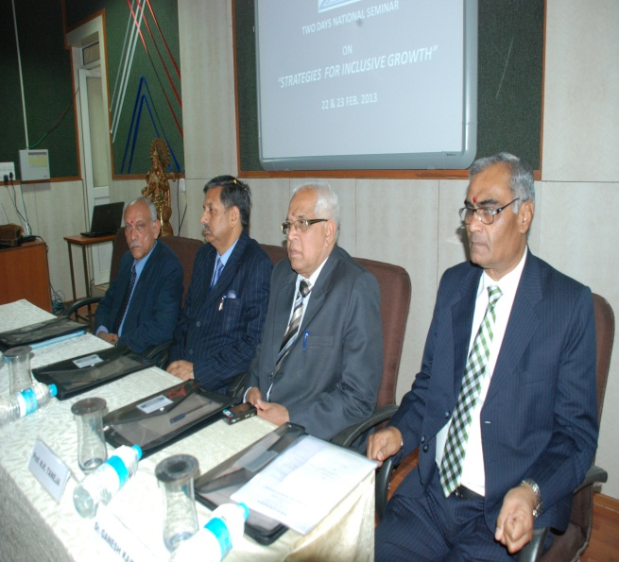
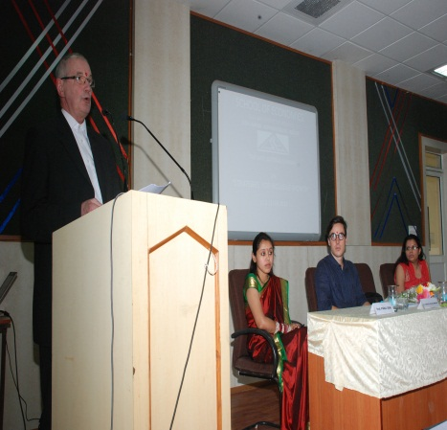
Strategies For Inclusive Growth 22-23 Feb, 2013

Slide 27
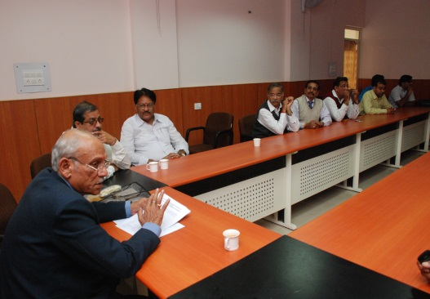
Workshop on API Score

Slide 28
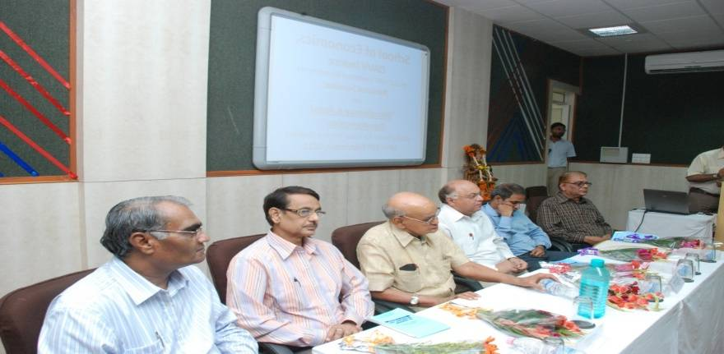
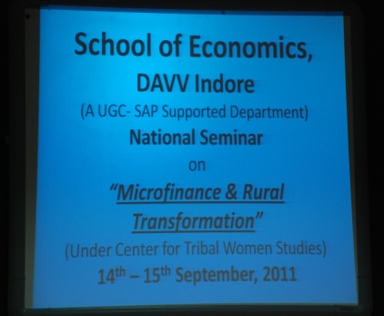
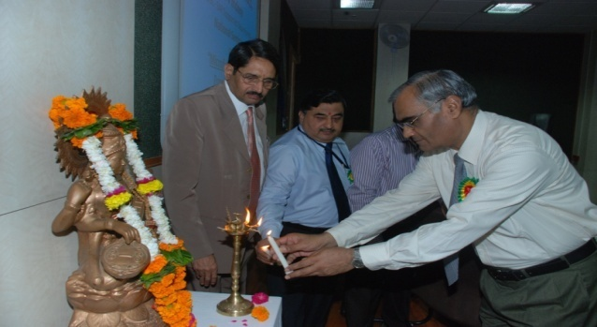
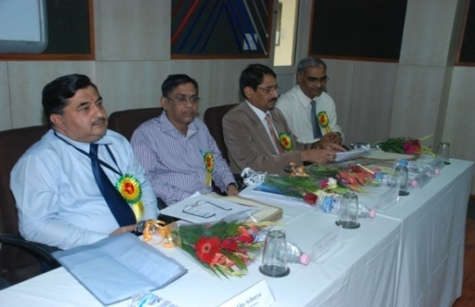
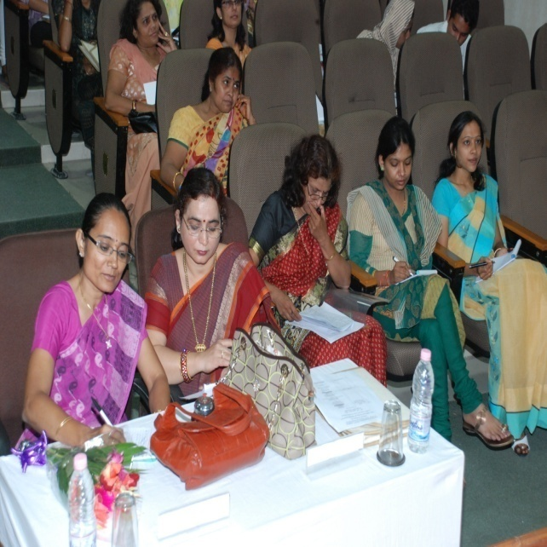
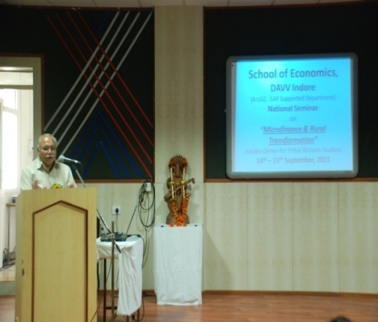

Slide 29
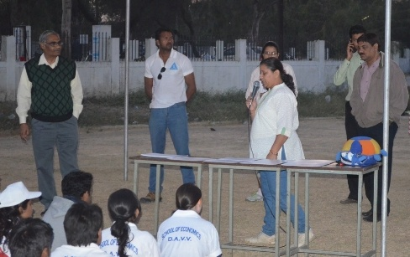
Spandan 2012

Slide 30
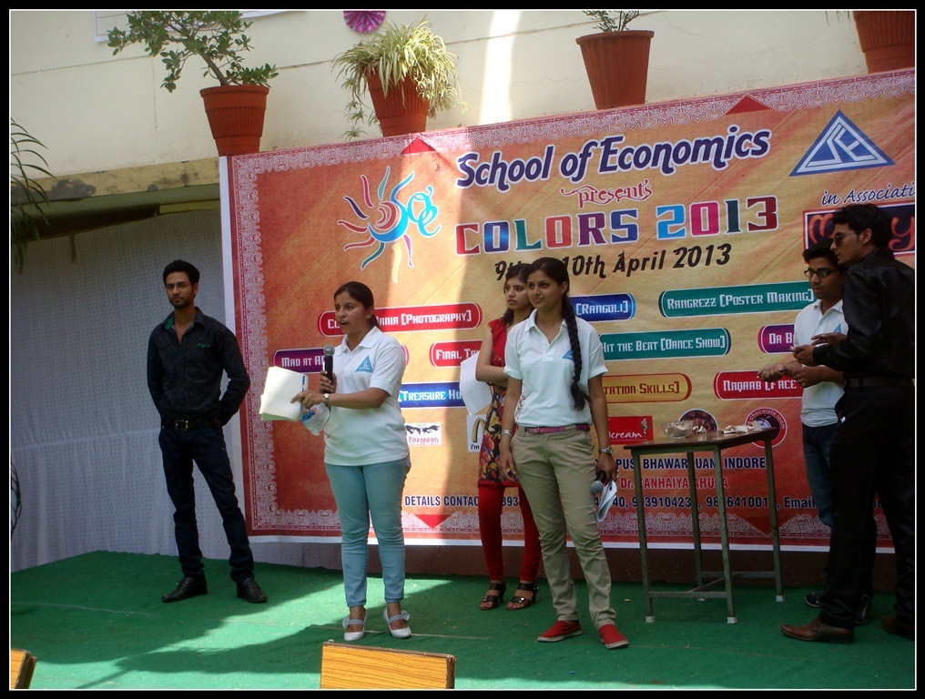
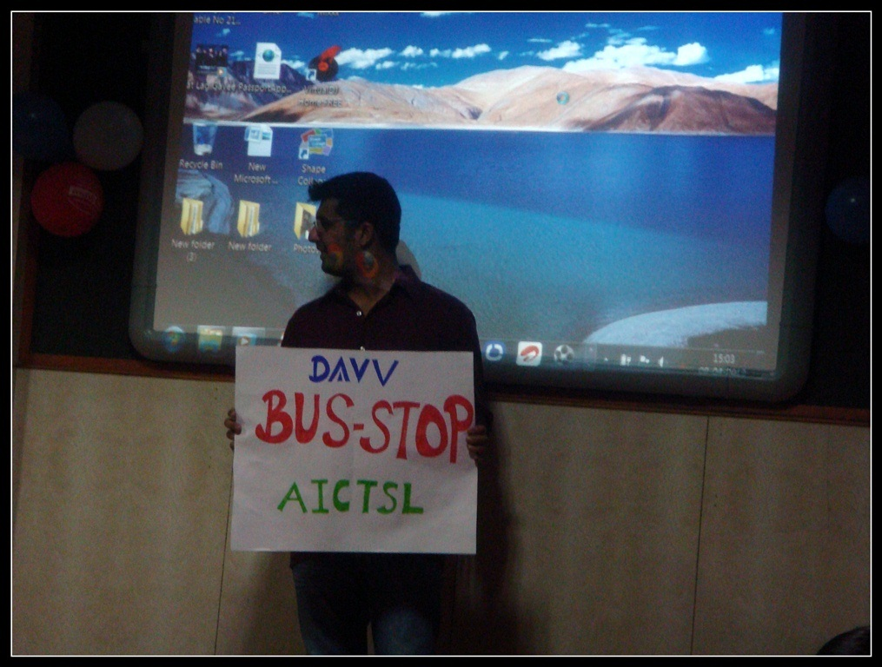
Colors 2013

Slide 31
Plantation Drive (17th June, 2013)

Slide 32
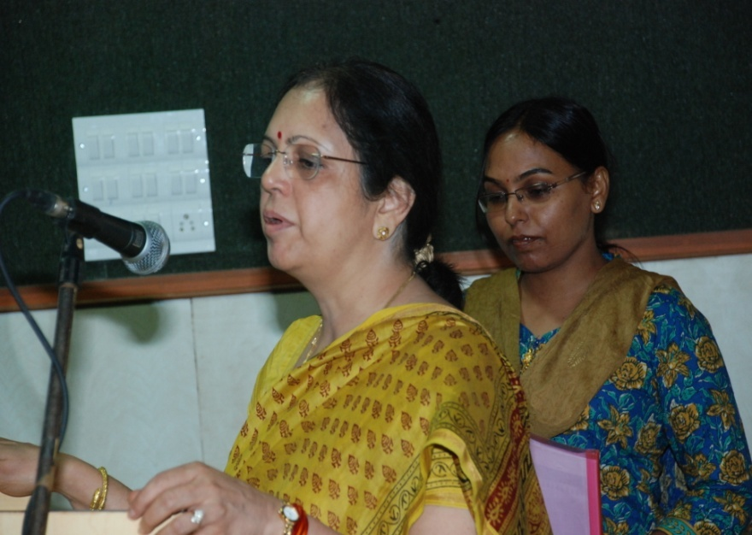
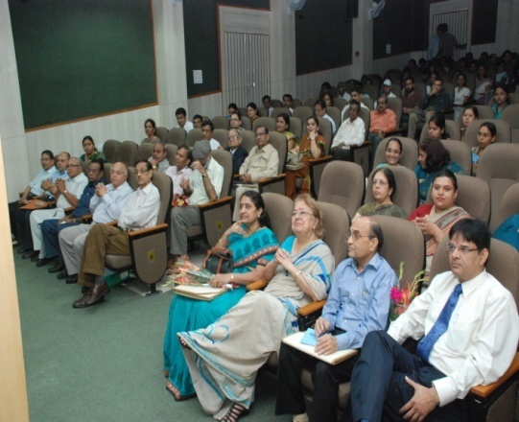
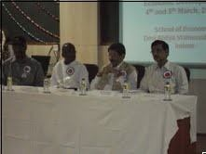
Climate Change and Economic Development, 12th -13th March, 2010
Natural Resources and Economic Development, 4th -5th March, 2011

Slide 33
Curriculum Revision
Syllabus Review Committee
Members: Teachers, Student, External Experts and Faculty Members from Affiliated Colleges.
Follow UGC guidelines and the NET Syllabus
Last Review Workshop was held on 5th August 2013 and 14th August 2013
Employability and Subject Knowledge are the basic components of the Curriculum Revision

Slide 34
Curriculum Feedback
External Experts: Quality of Question Papers, Coverage of Syllabus and Standard of Evaluation.
Students: Subject-wise feedback on a five-point scale is taken online at the end of the semester.
The analysis of feedbacks are duly communicated to the concern faculty members for their own assessment and self improvement.
Measures are taken to improve the quality of teaching on the basis of student feedback.

Slide 35
Student Feedback
Components
Conceptual Clarity
Communication
Regularity and Punctuality
Motivation
Completion and Coverage
Use of ICT

Slide 36
Academic Flexibility
Academic Flexibility
Semester and Grade System
Choice based Credit System
MRP and Summer Internship
Credit System-120
(104 Actual and 16 Virtual)

Slide 37
Choice-based Credit System
Subjects | Credits
Core | 48
Elective | 32
Soft Skills | 6
Interdisciplinary | 6
Project | 12
Virtual | 16

Slide 38
Curriculum Enrichment
ENRICHMENT
Foreign Languages
German/French
Professional Courses
Goods and Services Tax
Operation of Capital Market
Personality Development Workshops
Conventional Courses
Communication Skills
Financial Markets

Slide 39
Student Admission
Professional Programmes
MBA (BE, IB, FS)
University
Common
Entrance Test
(CET)
Traditional Programmes
M.A.and M.Phil
Departmental
Entrance Test
(Central Admission Committee (CAC)
Doctoral Programme
Ph.D. Economics
Doctoral
Entrance Test
(DET)

Slide 40
Student Profile (Year Wise)

Slide 41
Students Admitted (Year Wise)

Slide 42
Teaching Quality
Faculty Members are from diversified fields
67% Ph.D. Holders
Pedagogy
Seminars and Special Lectures from Industry Experts
Panel and Group Discussions on Current Issues
Power point Presentations and Case Studies
Assignments,
Tutorials and Quizzes
Industrial and Field Visits

Slide 43
Academic Events

Slide 44
SAP Advisory Meeting

Slide 45
Publication Details (Year Wise)

Slide 46
Papers Published in Journals
Economic and Political Weekly, Mumbai
Man and Development, Chandigarh
Journal of Commerce and Management Thoughts, Pune
Journal of Economic Policy Research, Hyderabad
Madhya Pradesh Journal of Social Sciences, Ujjain
Knowledge Globalization Conference, Boston

Slide 47
Publication Details of the Department 2009-13 (Faculty Wise)
Name | Publications | Papers | Monographs | Chapter in Books | Edited Books
Dr. Ganesh Kawadia | 27 | 23 | 01 | 01 | 02
Dr.Gyan Prakash | 21 | 20 | 00 | 00 | 01
Dr. Nirupama Nagar | 02 | 02 | 00 | 00 | 00
Dr. Kanhaiya Ahuja | 23 | 17 | 00 | 02 | 02
Dr. Rekha Acharya | 12 | 12 | 00 | 00 | 00
Dr. Sakharam Mujalde | 09 | 09 | 00 | 00 | 00
Dr. Vishakha Kutumbale | 05 | 04 | 00 | 00 | 01
Dr. Akanksha Singhi | 11 | 11 | 00 | 00 | 00
Dr. Vidya Telang | 03 | 03 | 00 | 00 | 00

Slide 48
Resource Persons and Paper Presentation
Faculty | Keynote Address/ Lecture | Special Lectures | Paper Presentation
Dr. Ganesh Kawadia | 11 | 48 | 04
Dr.Gyan Prakash | 00 | 04 | 00
Dr. Kanhaiya Ahuja | 01 | 26 | 06
Dr. Rekha Acharya | 01 | 12 | 07
Dr. Vishakha Kutumbale | 00 | 03 | 01
Dr. Akanksha Singhi | 00 | 01 | 05

Slide 49
Ph.D. Awarded 2009-2014
Year | Ph. D Thesis Submitted/Awarded
2009-2010 | 04
2010-2011 | 11
2011-2012 | 06
2012-2013 | 08
2013-2014 | 02

Slide 50
Faculty Enrichment Strategies
Self-Appraisal and PBAS: Timely submission by Faculty Members to the University
Refresher Course for the Teachers
Seminars and Panel Discussion on Current Issues
Provide Financial Support for Paper Presentation in National and International Seminars

Slide 51
Refresher Course
Year | Themes | Period
2013-14 | Recent Trends in Economic Policies | 23rd Aug. to 12th Sept 2013
2012-13 | Economics & Policy | 9th to 29th Jan 2013
2011-12 | Economics & Policy | 28th Dec. to 17 Jan 2012
2010-11 | Managerial Economics | 4th to 24th Dec 2010
2009-10 | Research Methodology in Social Science | 27th Jan. to 16th Feb 2010
2008-09 | Research Methodology in Social Science | 11th Feb. to 3rd Mar 2009

Slide 52
Faculty Enrichment
Date/Year | Orientation /Refresher Course/Winter School | Faculty
26th May to June 21, 2008 | National Institute of Public Finance and Policy | Dr. Sakharam Mujalde
2nd to 22nd January, 2009 | Academic Staff College, DAVV | Dr. Kanhaiya Ahuja
 |  | Dr. Rekha Acharya
 |  | Dr. Vishakha Kutumbale
 |  | Dr. Akanksha Singhi
27th Jan to 16th Feb 2010 | Academic Staff College, DAVV | Dr. Rekha Acharya
21st June to 18th July, 2011 | Academic Staff College, DAVV | Dr. Vishakha Kutumbale
 |  | Dr. Akanksha Singhi
 |  | Dr. Sakharam Mujalde
 |  | Dr. M.V.Khan
 |  | Ms. Ekta Rokade
28th Dec, 2011 to 17th Jan, 2012 | Academic Staff College, DAVV | Dr. Kanhaiya Ahuja
23rd Aug to 12th Sept , 2013 | Academic Staff College, DAVV | Dr. M.V. Khan

Slide 53
Resource Mobilization
Name of Agency | Year | Title | Amount
UGC- SAP | 2009-14 | SAP Project at DRS II Phase | Rs. 41,000,00 + P.F. Two
ICSSR Workshops | 2013-14 | Research Skill Enhancement Programme for Social Sciences | 9,40,000
Institute of Chartered Accountants of India | 2013-14 | ‘Goods and Service Tax | Rs 75000
Development Foundation Indore | 2012-13 | “Development Prospects of Madhya Pradesh” | Rs. 50000
Forward Market Commission | 2008-09 | Awareness on Commodity Derivatives | Rs. 1,72,280
State Planning Commission | 2014-15 | Chair on Micro Economic Governance | Rs. 50,00,000
ICSSR Projects | 2009-2013 | Major Research Projects | 1542625
Total |  |  | 11879905

Slide 54
Infrastructure
Conducive Infrastructure Ensures a Perfect Ambience for Academic Pursuits.
Eco - Friendly Building
Well Equipped Computer Lab Sufficed with Latest Software
Air Conditioned Auditorium with a Capacity of 160 People
Exclusively Facilitated Placement Room
Interactive Boards in Placement Room and Auditorium
Girls Common Room
Faculty Rooms and Cabins with 24*7 Internet Facilities

Slide 55
Departmental Library As A Learning Resource
Journals /Periodicals/Magazines: 43
Total area of the library (in Sq.ft): 1800
Total seating capacity: 65
Ratio of library books to students enrolled: 32
Average user ratio: 80 /day
Total books in the Departmental Library: 11562
We have a collections of books, National and International journals, CDs,
Computers are available in the library for administrative use and students’ access
Institutional Repository (MRPs, Research Papers, Dissertations and Thesis)
e-learning (subscription to various online journals)
We maintain the card system for the students

Slide 56
IT Infrastructure
Number of systems with individual configurations: 85
Computer-student ratio: 1: 4.5
Student User Ratio: 30 Per day
LAN facility through university IT centre
Proprietary software: Microsoft office 2010, Antivirus
Number of nodes/ computers with internet facility: 85
Other packages STATA, TORA are under process of acquiring
Class Rooms with LCD Projectors: 08
Portable LCD with laptop: 01
LCD equipped Placement room, Auditorium and Wi-fi campus

Slide 57
Student Support and Progression

Slide 58
Student Support and Progression
The course plan is uploaded on the website, which covers Course Overview , Learning Outcomes, Pedagogy, Examination Scheme, Session Plan, books and e-resources
Department provides support for various competitive exams like RBI , UGC-NET, UPSC, MPSC, IBPS.
Placement Cell facilitates Campus Recruitment Programmes
Departmental Committees like Anti-ragging, Grievance and Redressal cell, Mentors are there to support students

Slide 59
Student Progression 2012-13
Student Progression | No. Against Enrolled
PG to M.Phil. | 04 out of 20
PG to Ph.D. | 08 out of 150
Employed Campus selection Other than campus recruitment | 16 out of 150 ---

Slide 60
Results Analysis 2011-2013
Programme | 9 pointer | 8 pointer | 7 pointer | 6 pointer | 5 pointer | 4 pointer | Total
MBA (FS) | 1 | 9 | 12 | 12 | 5 | -- | 39
MBA (BE) | -- | 3 | 13 | 19 | 13 | 4 | 52
MBA (IB) | -- | 4 | 14 | 16 | 18 | 1 | 53
MA | 2 | 2 | 7 | 2 | 1 | -- | 14
M.Phil(2012-13) | 1 | 5 | 8 | 2 | 5 | -- | 21

Slide 61
Student Progression 2012-2013
Student Names | Competitive Examination
Kapil Patidar | INDIAN ECONOMIC SERVICES 2012
Amey Sapre | UGC NET 2012
Era Tiwari | JRF, UGC NET 2012
Rajesh Kumar Gautam | Lectureship, UGC NET 2012
Sumit Kumar Malviya | Lectureship, UGC NET 2012
Sunil Kumar Meena | Lectureship, UGC NET 2012
Ajeet Kumar Sahu | Lectureship, UGC NET 2012
Mohitash Nagotra | Lectureship, UGC NET 2012
Pooja Patharia | Lectureship, UGC NET 2012
VikashVerma | Lectureship, UGC NET 2012
Madhubala Kashyap | MPPSC, 2013

Slide 62
Placement Record
Batch 2009-11
COMPANY | STUDENTS PLACED
RUCHI SOYA INDUSTRIES LTD | 10
GREENBACK FOREX PVT LTD | 4
E-CLERX LTD | 5
CAPITAL VIA GLOBAL RESEARCH LTD | 7
HDFC SALES PVT LT | 16
SECUREDENT DENTAL CLUB PVT.LTD. | 1
AMERICAN EXPRESS | 1
BRIDGE STONE LTD | 1
HSBC BANK | 1
SBI | 1
SHAKTI PUMPS (INDIA) LTD | 1
Total | 38

Slide 63
Placement Record
Batch 2010-12
COMPANY | STUDENTS PLACED
GREENBACK FOREX PVT LTD | 3
E-CLERX LTD | 11
ARI HEALTHCARE PVT LTD | 1
SAILOR EXPORTS PVT LTD | 1
AUTHBRIDGE RESEARCH SERVICES PVT LTD | 1
HDFC SALES | 1
ONICRA CREDIT RATING AGENCY | 4
CAPITAL VIA GLOBAL RESEARCH LTD | 2
ATHENA TRADEWINDS PVT. LTD. | 1
BINARY SEMANTICS LTD | 3
CAPITAL VIA GLOBAL RESEARCH LTD | 17
FEDERAL BANK | 1
ICICI BANK | 2
FEDRATION OF INDIAN WOMEN ENTREPRENEURS(NGO) | 2
INDUSLAND BANK LTD | 1
Total | 51

Slide 64
Extension Activities
Creating Mass Awareness about Blood Donation
Shramdaan: For Clean and Green Campus
Tree Plantation: 17th June 2013
Tree Plantation: 12th July 2012
Film on the Problem of Desertification: 17th June, 2013

Slide 65
Student’s Participation and Activities
COLORS: ANNUAL MANAGEMENT FESTIVAL
SPANDAN: ANNUAL SPORTS MEET
PLACEMENTS AND INDUSTRY VISITS
ALLUMNI MEET
WORKSHOPS, SEMINARS, GD&PI

Slide 66
Governance, Leadership And Management
Participatory Decision Process
Course Coordinators: Different Coordinators for all Programmes
Various Committees: Anti-ragging, Grievance Redressal Cell
Student Participation: In-house Activities and Inter Institutes Competitions

Slide 67
Internal Quality Assurance System
Department has Internal Quality Assurance Committee for regular Internal Academic Audit
Regular interaction between IQAC of the Department and IQAC of the University
Submission of Academic Audit Report to the University
Submission of Student Feedback Analysis

Slide 68
Best Practices
Green Audit: School of Energy & Environmental Studies
Academic Audit: External Expert
UGC-SAP Advisory Body Meets regularly
Faculty Publications are placed in the Library
Short term fellowships for M. Phil and M.A. students
Post Doctoral fellowship under SPC - Chair
Students achievements are highlighted on the departmental website: www.soedavv.ac.in
International Cooperation Cell: Promotion of foreign Collaboration and Admissions
Semester Results declared within 15 days of Examination.
(July-December, 2013 declared on 14th January, 2014)

Slide 69
Innovations
The development of Multi - Disciplinary Programmes to meet the demand of growing market environment
Integration of Economics with Management, Finance, Marketing and International Business.

Slide 70
Plans Envisioned
Webinars
Foreign Collaboration
Virtual Classroom
E-library
Display Projects and Publications in Departmental Library

Slide 71
Thanks for
Visit to the Department

